Slide 1
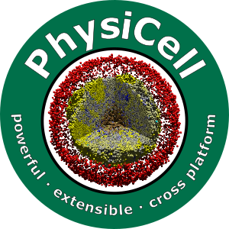

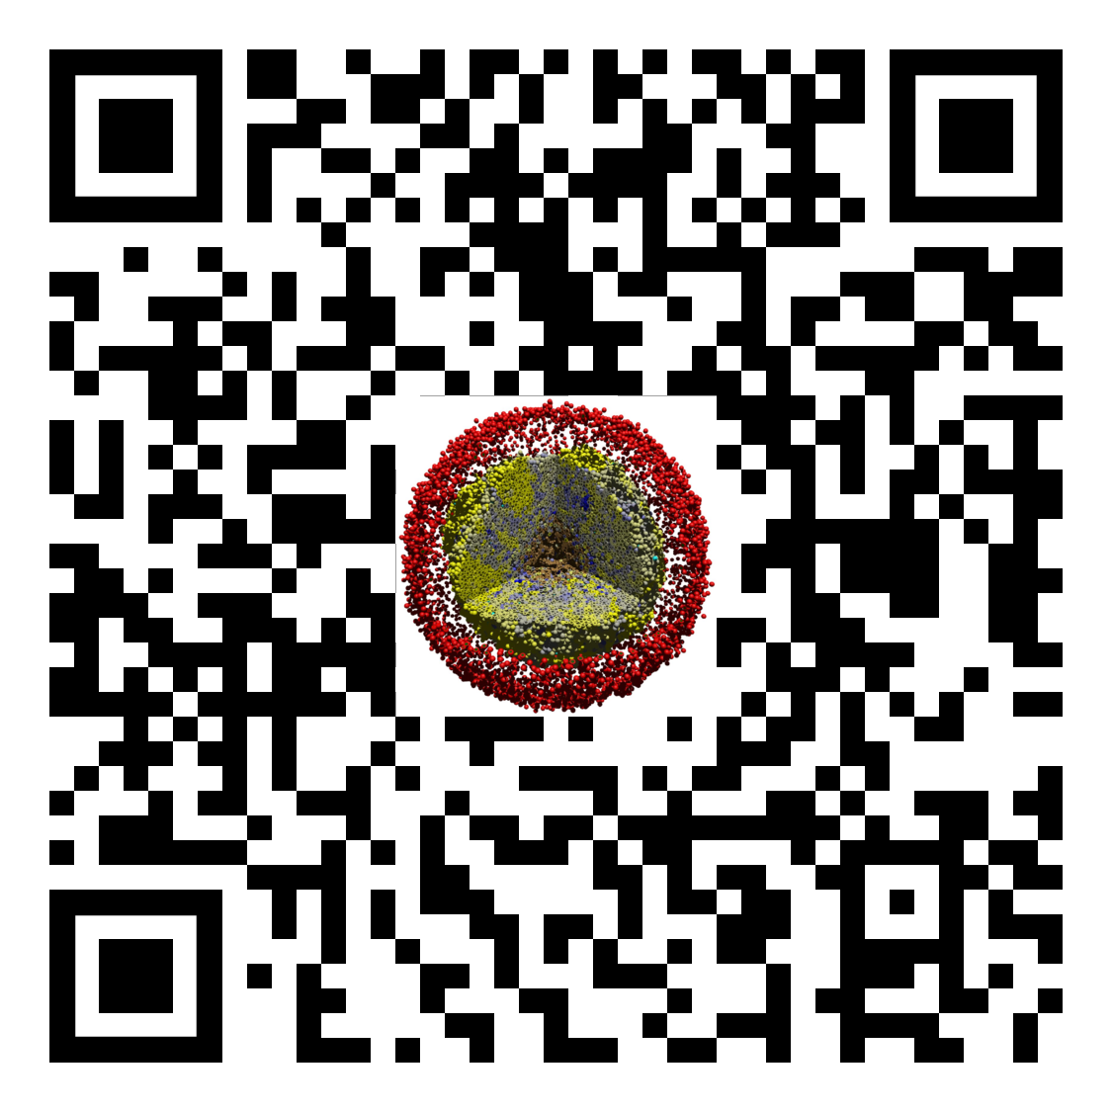
Lesson 3: What is an agent-based model?
Slides, videos, links and more:
https://github.com/physicell-training/03-What-is-ABM
Paul Macklin, Ph.D.
@MathCancer
last updated: February 3, 2020

Slide 2
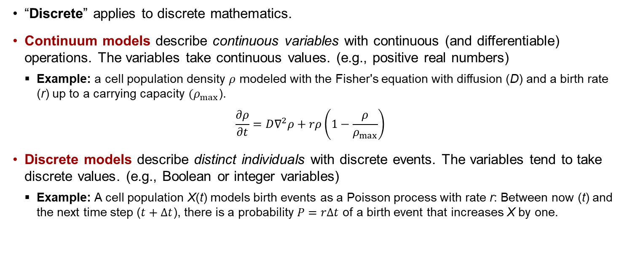
What is a discrete model?
“Discrete” applies to discrete mathematics.
Continuum models describe continuous variables with continuous (and differentiable) operations. The variables take continuous values. (e.g., positive real numbers)
Example: a cell population density $ρ$ modeled with the Fisher's equation with diffusion (D) and a birth rate (r) up to a carrying capacity $(ρ_{max}$).
$$\frac{∂ρ}{∂t}=D∇^{2}ρ+rρ\left(1−\frac{ρ}{ρ_{max}}\right)$$
Discrete models describe distinct individuals with discrete events. The variables tend to take discrete values. (e.g., Boolean or integer variables)
Example: A cell population X(t) models birth events as a Poisson process with rate r: Between now (t) and the next time step ($t+Δt$), there is a probability $P=rΔt$ of a birth event that increases X by one.

Slide 3
What is an agent-based model?
An agent-based model (in biology) is a type of discrete model that simulates individual cells.
Also referred to as individual-based models or cell-based models.
Agent-based models are often combined with continuum models of the microenvironment (e.g., partial differential equations for signaling factors), resulting in hybrid discrete-continuum (HDC) models.
Object-oriented programming (OOP) is ideal for agent-based modeling:
Modeling work focuses on individual cells
Each cell is an independent agent that carries its own data, and has its own behavioral rules
Use OOP: Define a cell class with member data and methods. Each cell is an instance of that class.
Agent-based models are a little closer to the biology:
Focus on modeling cells and their changing behavior.
Specific problems are then a matter of choosing the right rules.
You can tailor the level of detail: add molecular-scale biology to each cell if you need it.

Slide 4
What is agent-based modeling?
Each cell is treated as a separate software object (an agent)
Internal data (an internal state)
Position, Size, Cycle State, molecular variables, ….
Cellular processes
Cycling, Death, Motility, Growth, Adhesion, …
Virtual cells move a simulated virtual (micro)environment
Generally liquid (e.g., water or interstitial fluid)
Chemical movement (oxygen, glucose, signaling factors)
Typically diffusion -- solve partial differential equations (PDEs)
May also require advection for environments with flow
May include mechanical structures like extracellular matrix (ECM)
Finite element methods or related methods

Slide 5
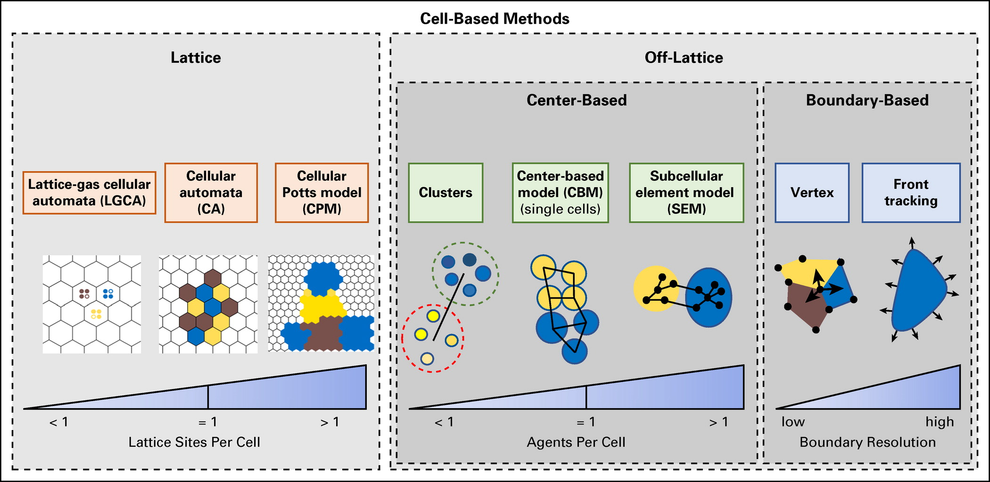
Typical approaches

Slide 6
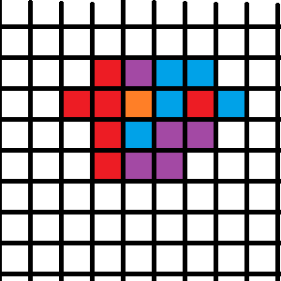
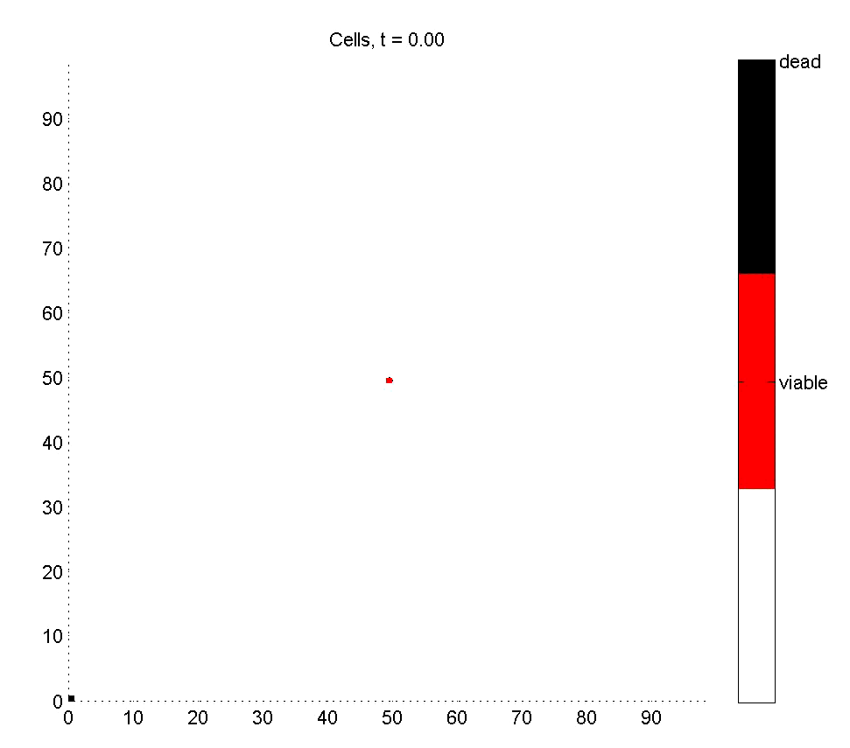
Cellular Automata
Approach:
Divide space into a lattice
Each lattice site holds 0 or 1 cell
Update each lattice site based on rules
Pros:
Easy to program
Very, very fast
Easy to swap in new hypotheses
Cons:
Lattice effects (& hidden assumptions)
All cells are the same size
No tissue mechanics
Update order biases
Usually solved with Monte Carlo (random update ordering)
Ideal use case:
Early qualitative tests of hypotheses

Slide 7
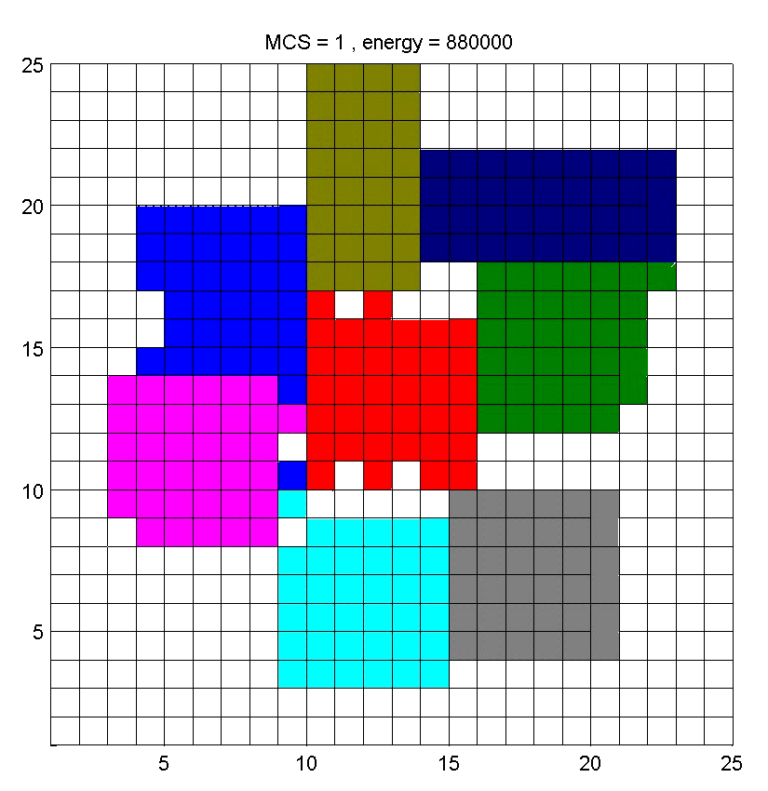
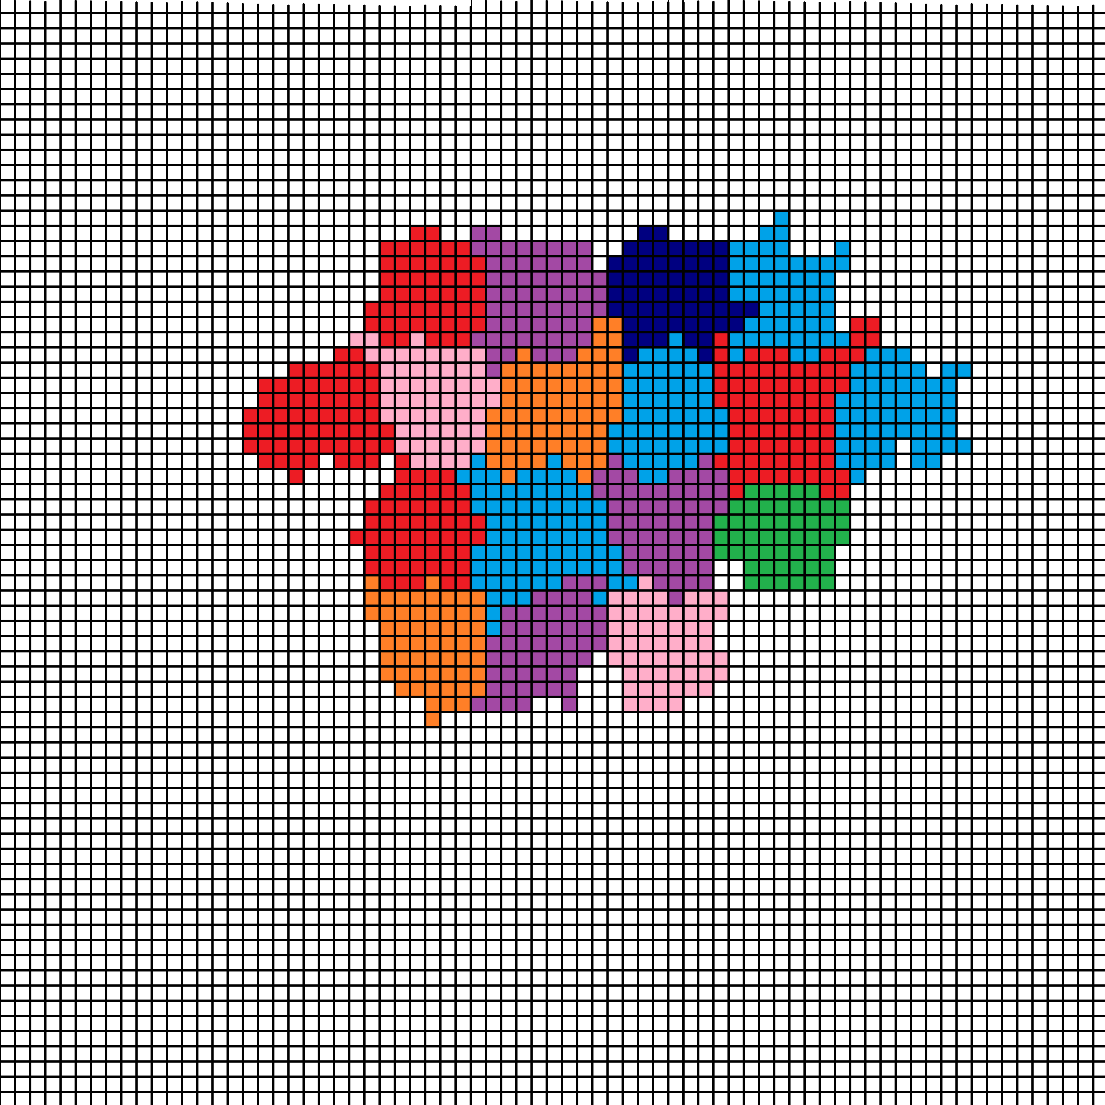
Cellular Potts
Approach:
Use a smaller mesh: multiple pixels per cell
Minimize a specially-chosen energy
Randomly try to swap pixels
Accept if energy is lower
Pros:
Now we get cell shape and size
More realistic
Mature codes such as CompuCell3D and Morpheus
Cons:
No true time: Monte Carlo steps and “temperature”
Have to translate biology into energy
Unexpected correlations can pop up from the global energy
Needs expert coding to be fast
Ideal use case:
Qualitative tests of hypotheses where mechanics matter

Slide 8
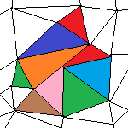
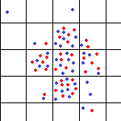
Some other approaches
Cellular automata on irregular meshes
Use an irregular mesh
Gets rid of grid bias issues
But still no control over individual cell sizes
Still no mechanics
Lattice-gas
Treat space as a series of connected boxes
Each box contains one or more cells
Pre-defined “channels” for cell movement between boxes
A nice bridge towards continuum models

Slide 9
Still more approaches
Vertex-based models:
Densely packed cells look like polyhedral
Model the movement of the vertices, instead of the cells
Center-based models:
Model movement of cell centers
Write out force diagram (classic physics!)
Append extra biology to each cell as needed

Slide 11
from mcsb

Slide 12
Typical program flow
Read parameters
Set up microenvironment
Create meshes, initialize chemical substrates, diffusion solvers, etc.
Set up cell agents
Define all cell types
Instantiate cells
For each time:
Update microenvironment
Solve reaction-diffusion equations (as needed)
Solve tissue mechanics (as needed)
Update each cell's state
Sample environment
Run signaling model (as needed)
Update behavioral parameters based on signaling model and sampled environment
Run cell process models (growth, cycling, death, …)
Calculate cell velocities
Update cell positions
Advance time

Slide 13
standard stuff

Slide 14
Next steps
Super fast: Please proceed to 4 (Introduction to PhysiCell) link: https://github.com/physicell-training/04-PhysiCell-intro
Intermediate: Please proceed to 4 (Introduction to PhysiCell) link: https://github.com/physicell-training/04-PhysiCell-intro
Full training: Please proceed to 4 (Introduction to PhysiCell) link: https://github.com/physicell-training/04-PhysiCell-intro
More materials: https://github.com/physicell-training/master-list

Slide 15




Credits
Lesson Planning: Paul Macklin
Slides: Paul Macklin
Recording: Paul Macklin
Post-production: Paul Macklin, Drew Willis*, Kali Konstantinopoulos*
Microapps: https://www.nanohub.org/tools/???
* denotes undergraduate researcher
Funding:
PhysiCell Development:
Breast Cancer Research Foundation
Jayne Koskinas Ted Giovanis Foundation for Health and Policy
National Cancer Institute (U01CA232137)
National Science Foundation (1720625)
Training materials:
* Administrative supplement to NCI U01CA232137 (Year 2)

